Slide 1
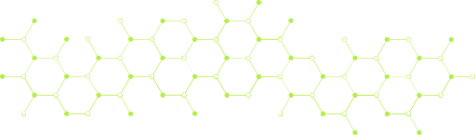


SAN FRANCISCO STATE UNIVERSITY
DEEP LEARNING CSC 671
FALL 2024
DEEP LEARNING PROJECT
Team 1
Paige Hodgkinson
Sid Padmanabhuni
Chun-Wei Pan

Slide 2
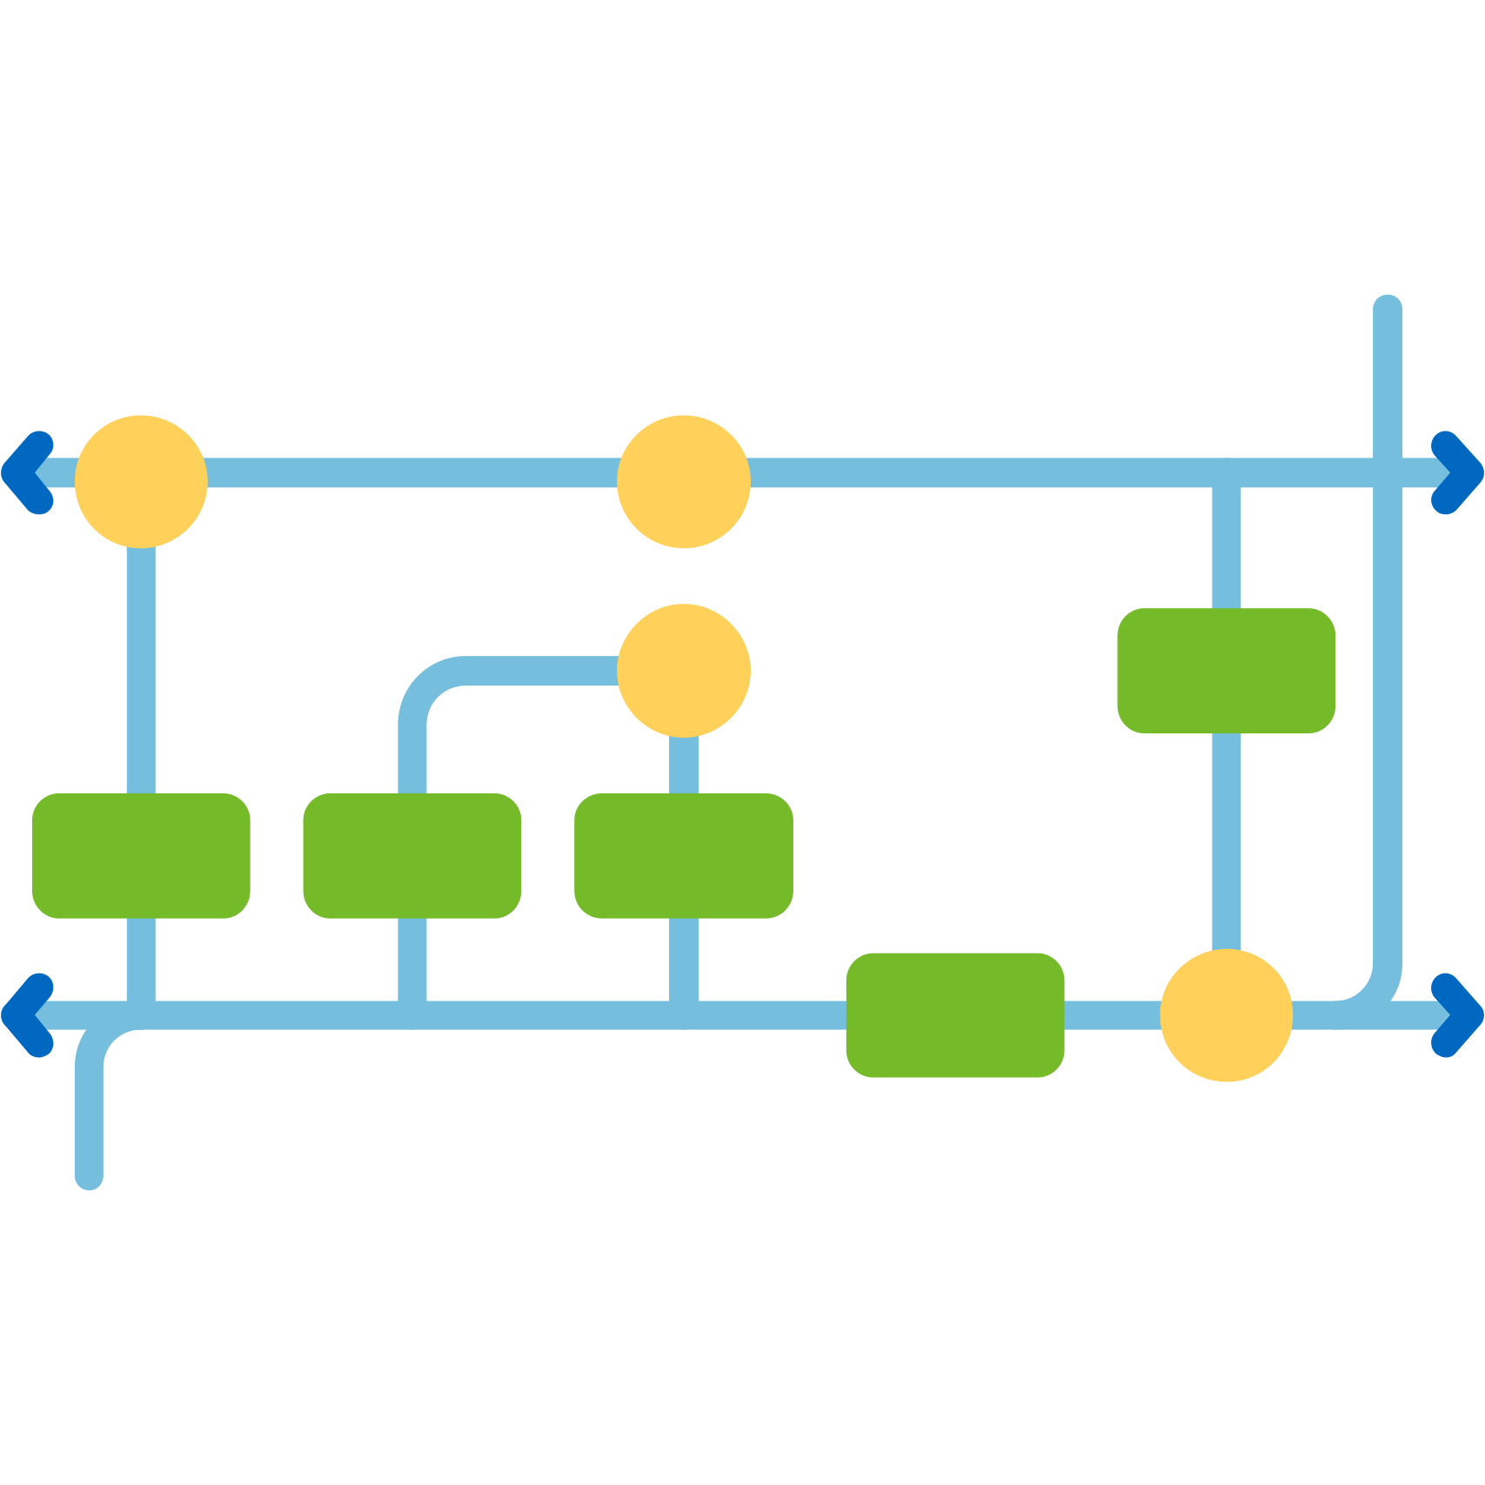
LSTM MODEL
(LONG TERM SHORT-TERM MEMORY MODEL)
FOR TEXT GENERATION

Slide 3

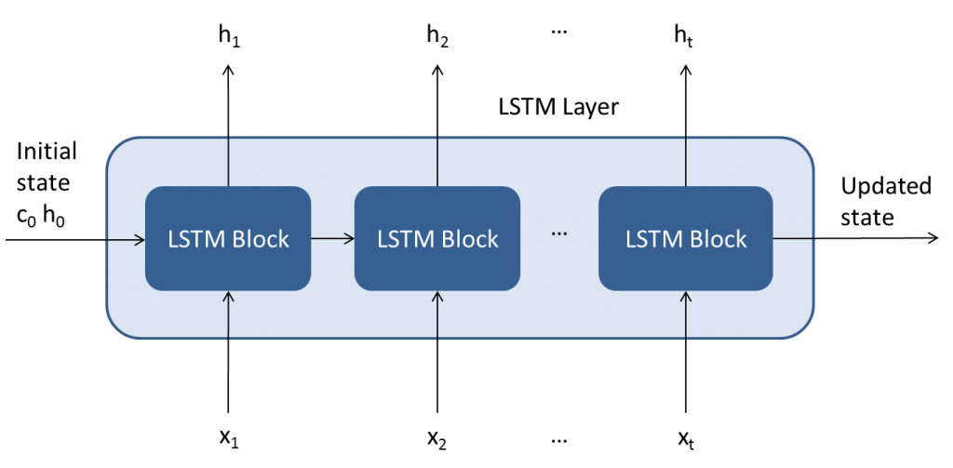
THE LSTM MODEL
Overall Layer Compostition
Long Term Dependencies
Each Unit Added- sequentially update a hidden state output vector from the previous cell. Use this in the next LSTM block calculation.
Avoid Vanishing Gradient
E
The cell state has a direct connection (a linear relationship) with the last cell state, so on backpropogation the derivative stays nonzero.

Slide 4
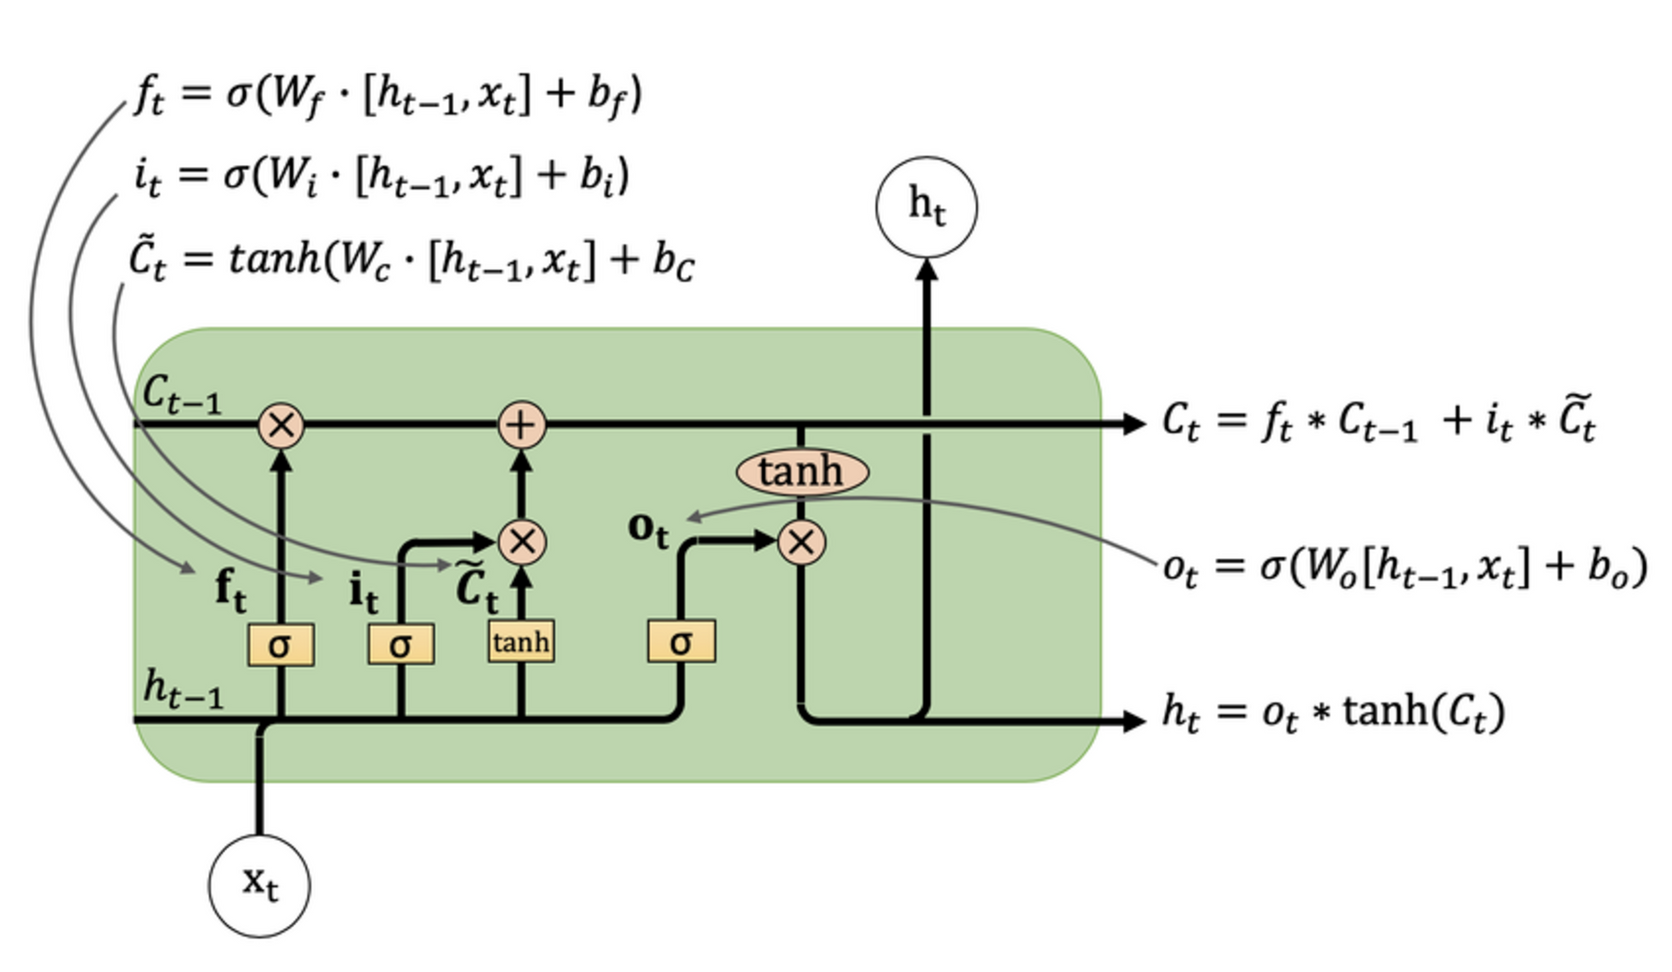
LSTM PROCESS

Slide 5


OUR MODEL DESIGN
ARCHITECTURE
2 STACKED LSTM LAYERS
BIDIRECTIONAL
FULLY CONNECTED OUTPUT LAYER
EMBEDDING LAYER
ATTENTION MECHANISM

Slide 6


OUR MODEL DESIGN
TRAINING
DATA PREPARATION
CROSS ENTROPY LOSS FUNCTION
ADAM OPTIMIZER
GRADIENT CLIPPING
LEARNING RATE SCHEDULING
DROPOUT
Adjusts learning rate for each parameter individually and is more effective at noise, local minima, and converges faster than say, SGD.
Clip backpropagated gradients at 5 initial. Prevents exploding gradient from outweighing the other features. Stabilizes the training process.
Decrease overall learning rate by a factor of 0.2 every 5 epochs as backpropogation converges to require more fine adjustment.
Data loaded, preprocessed (clean/tokenize), and portion to sequences.
For probability distribution loss of next word generated.
Intially set to 0.2. Prevents overfitting.
BACKPROPOGATE!

Slide 7

OUR MODEL DESIGN
EVALUATION
01
MODEL PREPARATION
02
TEXT GENERATION
03
USER INPUT/OUTPUT

Slide 8
OUR MODEL DESIGN
EVALUATION
01
MODEL PREPARATION
Loading Tokenizer: Loads a pre-trained tokenizer to convert text into numerical sequences and vice versa.
Setting Device: Selects the appropriate device (CPU or GPU) for model execution.
Defining Model : Defines the architecture of the model from training, including the number of layers, hidden units, and embedding dimensions.
Loading Pre-trained Model: Loads the weights of a pre-trained model from a saved file.
Setting Evaluation Mode: Sets the model to evaluation mode, disabling dropout layers to ensure consistent output.
02
TEXT GENERATION
03
USER INPUT/OUTPUT

Slide 9
OUR MODEL DESIGN
EVALUATION
01
Input
Seed Text: The initial text to start the generation process.
Next Words: The number of words to generate.
Temperature: A parameter to control the randomness of the generated text. Higher temperatures lead to more diverse but potentially less coherent output.
Top-k Sampling: A technique to limit the number of possible next words, improving efficiency and focusing on the most likely options.
Processing
Text Preprocessing: Filters out non-essential characters from the seed text.
Tokenization and Padding: Converts the text into numerical sequences and pads them to a fixed length, ensuring consistent input to the model.
Tensor Conversion: Converts the tokenized input into a PyTorch tensor suitable for model input.
MODEL PREPARATION
02
TEXT GENERATION
03
USER INPUT/OUTPUT

Slide 10
OUR MODEL DESIGN
EVALUATION
01
Model Forward Pass
Input Feeding: Feeds the prepared input tensor into the BiLSTM model.
Output Generation: The model processes the input and generates output logits, which are unnormalized probabilities for each word in the vocabulary.
Output Processing
Temperature Scaling: Adjusts the output logits by dividing them by the temperature parameter. Higher temperatures increase the randomness of the sampling process.
Top-k Sampling: Selects the top k most probable words based on the scaled logits.
Word Selection: Randomly samples one word from the top k words based on their probabilities.
Text Appending: Appends the selected word to the generated text.
MODEL PREPARATION
02
TEXT GENERATION
03
USER INPUT/OUTPUT

Slide 11
OUR MODEL DESIGN
EVALUATION
01
MODEL PREPARATION
02
User Input/Output
User Input: Prompts the user to enter a seed text.
Text Generation: Calls the generate_text function to generate the desired number of words based on the seed text and specified parameters.
Output Display: Prints the generated text to the console.
TEXT GENERATION
03
USER INPUT/OUTPUT

Slide 12

OUR MODEL DESIGN
OBSERVATION OF RESULTS
RESULTS COMPARISON
PERPLEXITY SCORE
HUMAN EVALUATION

Slide 13

METHODOLOGY
AND TEAM APPROACH

Slide 14

GOALS
Experimental setup for LSTM text generation model utilizing optimization and normalization techniques.
01
Design model to compute constraints
Including text dataset, dataset size, batch size (chosen according to VRAM max) according to our group compute.
02
Tune Hyperparameters
Evaluate via perplexity metric and time to train.
03
Generate visually intelligible output
Adjust model design as needed, and normalization between layers.

Slide 15

01 DESIGN MODEL TO COMPUTE CONSTRAINTS
Including text dataset, dataset size, batch size (chosen according to VRAM max) according to our group compute.
01.1
GPU size
01.2
Batch Size
01.3
Dataset and size

Slide 16
01 DESIGN MODEL TO COMPUTE CONSTRAINTS
Including text dataset, dataset size, batch size (chosen according to VRAM max) according to our group compute.
01.1
GPU size
1.5 hrs at only 0.5% of dataset size on our slowest team computer given a batch size of 64 (NVIDIA RTX 2000). This proved unfeasible for both our time and model accuracy because it was not enough data.

Slide 17
01 DESIGN MODEL TO COMPUTE CONSTRAINTS
Including text dataset, dataset size, batch size (chosen according to VRAM max) according to our group compute.
01.1
GPU size
Of our 3 computers, we decided to train on only 2 computers which could handle 5% of our original set.

Slide 18
01 DESIGN MODEL TO COMPUTE CONSTRAINTS
Including text dataset, dataset size, batch size (chosen according to VRAM max) according to our group compute.
01.1
GPU size
After adjusting our starting model (batch size, perplexity score, and alternative dataset) we reverted to only using the fastest computer to for hyperparameter tuning (NVIDIA 4090).

Slide 19

01 DESIGN MODEL TO COMPUTE CONSTRAINTS
Including text dataset, dataset size, batch size (chosen according to VRAM max) according to our group compute.
01.1
GPU size
01.2
Batch Size
01.3
Dataset and size

Slide 20
01 DESIGN MODEL TO COMPUTE CONSTRAINTS
Including text dataset, dataset size, batch size (chosen according to VRAM max) according to our group compute.
01.2
Batch Size
After deciding to train on only 2 computers...
We looked at VRAM for the slower computer of two (NVIDIA 4070) to increase the batch size until reaching just under the VRAM maximum at a batch size of 512.
This combination of compute was used for adding a perplexity score and using a new dataset.
This was the starting model, but batch sizes below this maximum would be tested in the tuning portion.

Slide 21
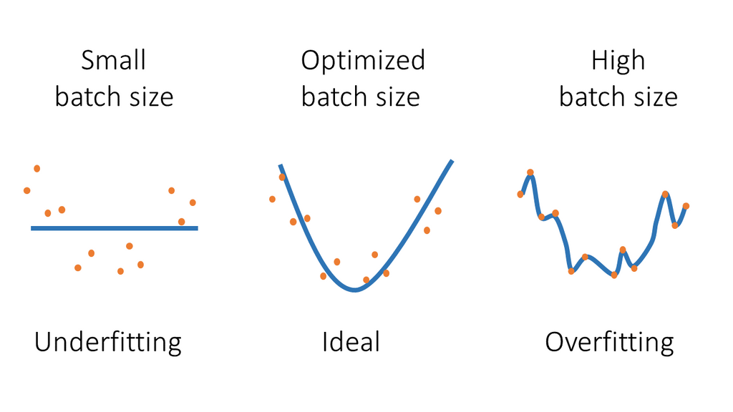
01 DESIGN MODEL TO COMPUTE CONSTRAINTS
Including text dataset, dataset size, batch size (chosen according to VRAM max) according to our group compute.
01.2
The logic here is to begin farther towards overfitting rather than risk underfitting, and to observe the minimum training time on the given dataset size.
Batch Size

Slide 22
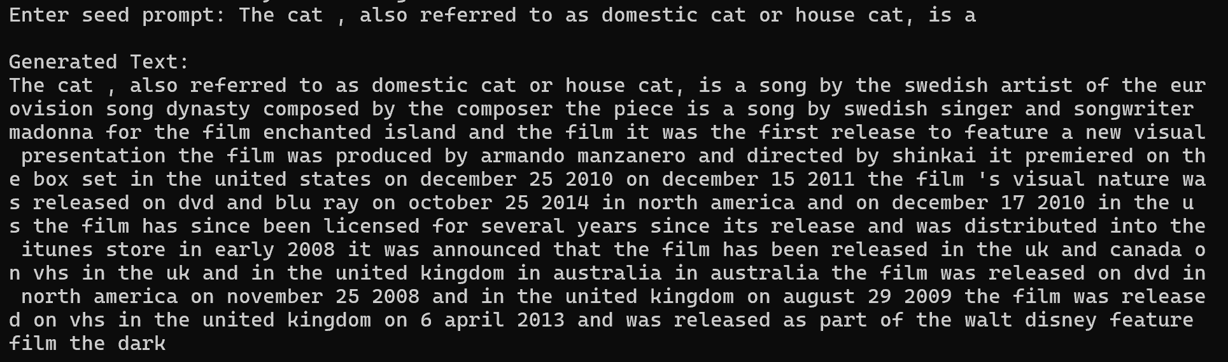
01 DESIGN MODEL TO COMPUTE CONSTRAINTS
Including text dataset, dataset size, batch size (chosen according to VRAM max) according to our group compute.
01.1
GPU size
01.2
Batch Size
01.3
Dataset and Size

Slide 23
01 DESIGN MODEL TO COMPUTE CONSTRAINTS
Including text dataset, dataset size, batch size (chosen according to VRAM max) according to our group compute.
01.3
Dataset and Size
Our dataset was significantly paired down in our initial setup of the model between 0.005-0.5% range.
This created a subset of the original dataset which was not uniformly distributed across the entire set, nor did we know the original distribution of the set to portion from.
HENCE THE MUSIC LOVING MODEL.

Slide 24
01 DESIGN MODEL TO COMPUTE CONSTRAINTS
Including text dataset, dataset size, batch size (chosen according to VRAM max) according to our group compute.
01.3
Dataset and Size

Slide 25

01 DESIGN MODEL TO COMPUTE CONSTRAINTS
Including text dataset, dataset size, batch size (chosen according to VRAM max) according to our group compute.
01.3
Dataset and Size
Even assuming we could create a uniformly distributed subset, such a large set meant that our model was likely to have trouble learning from a smaller dataset.
Therefore, a new dataset was chosen.
ORIGINAL DATASET SIZE (at 5%): 560 MB
NEW DATASET SIZE (at 1%) : 181 KB

Slide 26
01 DESIGN MODEL TO COMPUTE CONSTRAINTS
Including text dataset, dataset size, batch size (chosen according to VRAM max) according to our group compute.
01.3
Dataset and Size
We used 30% to train on our intial hyper parameter set to see how accurate of text generation we could get at a larger size
This took 10 hours 30 min
Hyperparameter tuning was performed at only 1%, for feasibility. We felt this was more educationally useful than trying to tune at 5% (1.5 hrs).

Slide 27

01 DESIGN MODEL TO COMPUTE CONSTRAINTS
Including text dataset, dataset size, batch size (chosen according to VRAM max) according to our group compute.
01.3
Results at 30% base model
Enter seed prompt: A video game is
Generated Text:
A video game is released in japan on march 2 2017 in japan the playstation vita playstation network windows playstation portable psp version is available in the united kingdom for microsoft windows playstation 3 playstation 3 and xbox 360 versions in the same version as the game 's first vita version of the game the ps2 version is based on two discs the game 's title version was released in japan on september 26 2003 but was released on september 30 2006 in europe and north america in north america on april 24 2005 a japanese version of the game was released in north america on december 4 2006 and november 24 2006 the north american version of the game was ported to the playstation 2 version of the game boy advance the game 's music was released in japan on may 25 2006 on june 22 2008 in europe and on july 6 2007 the game is the last game in the series to feature a demo and play for the player character development system which includes a new story and story mode that allows the player to complete a game the game was created and developed by crytek insomniac and published by

Slide 28

TUNING
HYPERPARAMETER OPTIMIZATION

Slide 29

HYPERPARAMETER SEARCH GRID
Base Model Indicator
Hyperparameter | Values | Time (ns/ms?) | Starting Loss @ (Epoch 1/10) | Final Loss @ (Epoch 10/10) | Perplexity Score
Initial Learning Rate | 0.001 | 8m, 42s | 7.2467 | 3.1587 | 1.01
 | 0.0005 | 8m, 44s | 7.5849 | 4.3629 | 1.01
 | 0.0001 | 8m, 42s | 7.8253 | 6.4655 | 1.01
Embedding Dimension | 100 | 8m, 33s | 7.4868 | 3.19 | 1.01
 | 150 | 8m, 42s | 7.2467 | 3.1587 | 1.01
 | 200 | 8m, 44s | 7.3953 | 2.805 | 1.01
Hidden Dimension | 128 | 2m, 47s | 7.6748 | 5.6147 | 1.01
 | 256 | 4m, 46s | 7.5804 | 4.6137 | 1.01
 | 512 | 8m, 42s | 7.2467 | 3.1587 | 1.01
Dropout Rate | 0.1 | 8m, 44s | 7.4151 | 2.5499 | 1
 | 0.2 | 8m, 42s | 7.2467 | 3.1587 | 1.01
 | 0.3 | 8m, 44s | 7.4752 | 3.2731 | 1.01
Sequence Length | 20 | 5m, 41s | 7.4171 | 2.8938 | 1.01
 | 40 | 8m, 42s | 7.2467 | 3.1587 | 1.01
 | 80 | 14m, 38s | 7.4542 | 2.9955 | 1.01
Batch Size | 64 | 26m, 17s | 7.1781 | 2.3529 | 1.04
 | 256 | 11m, 12s | 7.348 | 2.6544 | 1.01
 | 512 | 8m, 42s | 7.2467 | 3.1587 | 1.01

Slide 30
OPTIMIZED HYPERPARAMETERS
AT 1% DATASET SIZE
INITIAL LEARNING RATE
0.001
EMBEDDING DIMENSION
150
HIDDEN DIMENSION
512
DROPOUT RATE
0.2
SEQUENCE LENGTH
40
BATCH SIZE
512

Slide 31

NOTE
This is not the optimized set for all hyperparameters together, as for 18 variables this would require an 18x18 (324 runs) grid space to capture the complex effects of all of the variables on each other.
This would require 162 hours of runtime.
Each optimized hyperparameter here is individually varying from the BASE MODEL to give us an academic understanding of the effects on our model given computer system constraints.

Slide 32

CONCLUSIONS
Perplexity Score was not useful
Scores for all hyperparameters sets we almost the same.
Massive compute required for accuracy
To run in a reasonable time and run a true optimization, we would need massive compute power available like for our 30% single training.
LSTM is a robust model
We required very little regularization besides dropout.
More internal dimension (connections) = more accuracy for us
Increasing the embedding layer and hidden layer dimension converged better.
Smaller hyperparameters for the rest = more accuracy
Though smaller Initial Learning Rate, dropout rate, sequence, and batch size had less loss, the training took longer.

Slide 33
Thank you!
SAN FRANCISCO STATE UNIVERSITY
DEEP LEARNING CSC 671
FALL 2024
DEEP LEARNING PROJECT
Team 1
Paige Hodgkinson
Sid Padmanabhuni
Chun-Wei Pan

